Slide 2
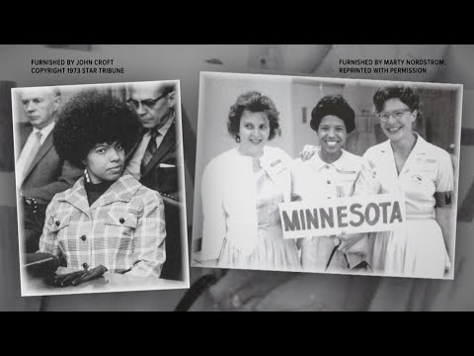
VOTE
Nov 2, 2021
Raise Your Voice
Morris County Jack and Jill of America, Inc. Legislative Committee
Your voice matters.

Slide 3
New Jersey General Election Dates
Nov 2, 2021
Voter Registration Deadline: Tues. Oct 12, 2021
*Teens who are 17 yrs old and will be 18 yrs old by Nov 2 may register.
In-Person Early Voting: Oct 23, 2021 - Oct 31, 2021
Vote By Mail Deadline: Nov 2, 2021- On or before 8:00 p.m. EST. Must be either placed in a secure ballot drop box, delivered in person to your county’s Board of Elections Office, or postmarked for November 2.
Request Vote by Mail Deadline: Tuesday, Oct 26, 2021
Morris County Jack and Jill of America, Inc. Legislative Committee

